Slide 1

Explainable AI & MLOps

Slide 2

Know the Presenter
Abilash B
Lead - Data Scientist,
Fidelity Investments
Notes:
Financial Operations
Reconciliation
Risk Mitigation
Anomaly detection

Slide 3




Know the Presenter

Slide 4
Agenda
Machine Learning – A Brief Introduction
Explainable AI
MLOps

Slide 5
Why Machine Learning?
Section - 1

Slide 6
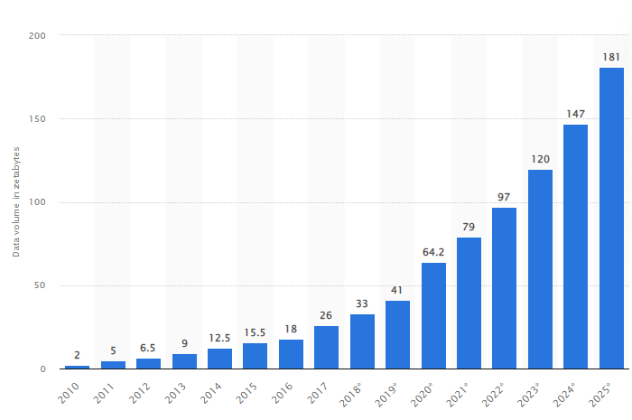
Growth of Data

Slide 7
The Global Data Science Market
$136.6 billion Current worth of AI market (2022)
1300%
Expected increase in total worth by end of 2030
97 million
No. of people estimated to be working in AI space by 2025

Slide 8
What is Artificial Intelligence?
Section - 1.1

Slide 9
The Big Picture
Artificial
Intelligence
Ability of machine to imitate human behavior
Machine
Learning
Subset of AI: Machine learns patterns and makes predictions
Deep
Learning
Subset of ML: Uses complex neural networks to train model

Slide 10






History of A.I.
2010's - now
Era of deep learning from Facial recognition to autonomous cars
1950
1955
1964
1989
2000's
2010's to now
1989
CMU pioneers the use of neural networks to steer autonomous vehicles
1955
John McCarthy coins the term "Artificial Intelligence"
1950
Alan Turing proposes a test for Machine Intelligence
1964
MIT Artificial Intelligence Laboratory creates a chatbot named "Eliza"
2000's
The Era of Big Data powering algorithms to learn more patterns

Slide 11

Algorithm finds pattern in data and learns on his own
Works with huge quantities of data
Finds hidden relationships or patterns
Makes intelligent suggestions
Use cases : Facial recognition & Product recommendation
Pattern based AI

Slide 12

Many successful AI systems are hybrid
Combination of rule-based, learning based and human intelligence
Use cases :
Self-driving cars
Rescue Drones
Hybrid AI

Slide 13
What is Machine Learning
Section - 1.2

Slide 14
A machine learning algorithm is an algorithm that learns from data to perform tasks improve the performance overtime without being explicitly programmed

Slide 15



Machine Learning
Process huge volume of data
Identifies hidden patterns
Makes insight based decisions

Slide 16
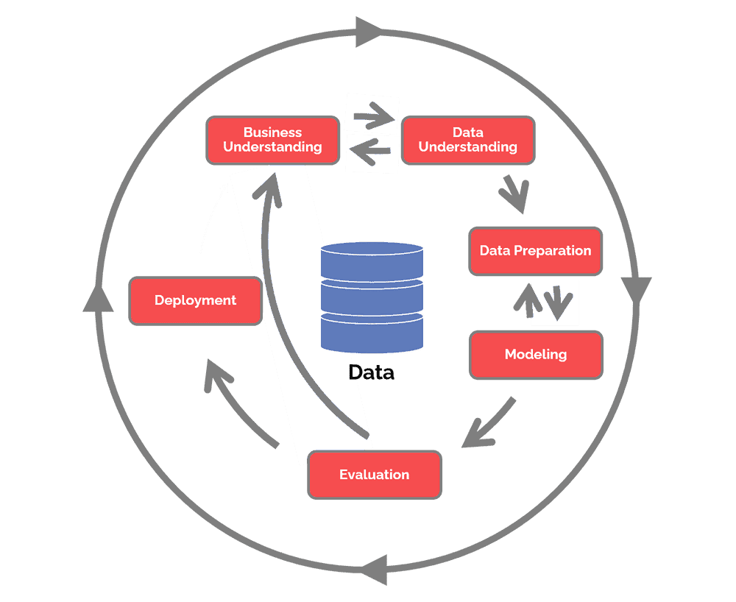

CRISP-DM
CRoss Industry Standard Process for Data Mining

Slide 17



Types of Machine Learning
Supervised Learning
Unsupervised Learning
Reinforcement Learning

Slide 18



Types
Supervised Learning
Classification
Regression

Slide 19


CLASSIFICATION PREDICTS THE CATEGORY THE DATA BELONGS TO
REGRESSION PREDICTS A NUMERICAL VALUE BASED ON PREVIOUSLY OBSERVED DATA.

Slide 20
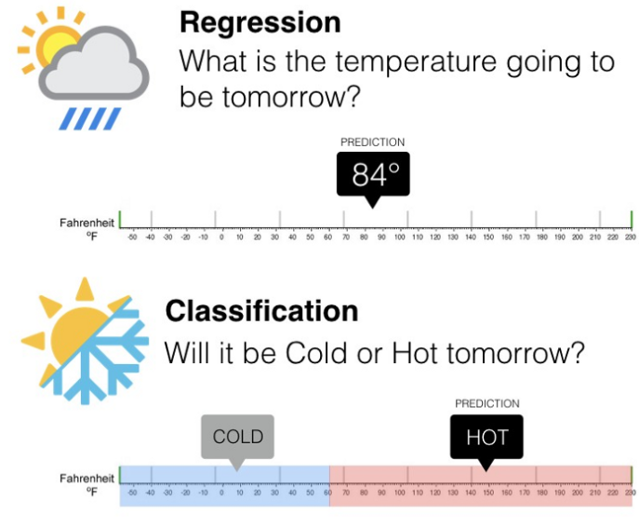

Slide 21
Explainable AI
Section - 3

Slide 22
Can you trust your model just because it has high accuracy?

Slide 23
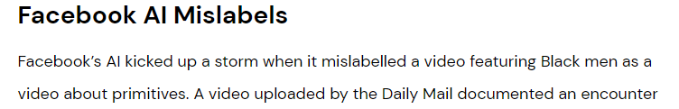
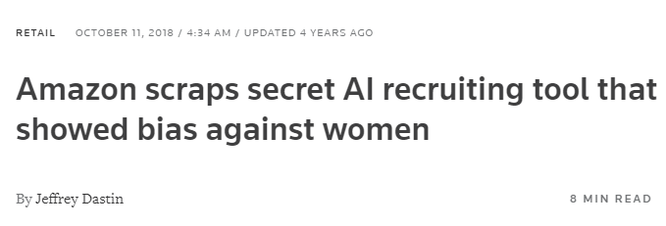
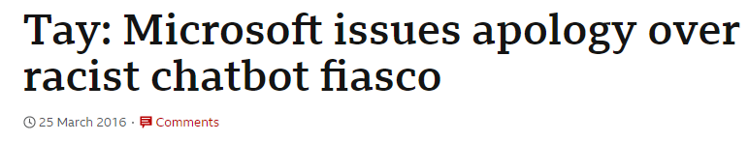
Why explainable AI?

Slide 24
Evolution of AI Adoption
Symbolic AI
Logical rules represent knowledge
No learning capability
Statistical AI
Specific domains training on Big Data
Black box models
Explainable AI
Explanatory models
Learn and reason with new situations

Slide 25

What is XAI?
Explainable AI (XAI) is a set of processes and methods that allow human users to comprehend and trust the results produced by machine learning algorithms

Slide 26

Explainable AI
Black-box AI
Obscurity of Blackbox AI
Why did you do that?
Why did you not do that?
How do I correct an error?
Data
Black-Box AI
AI Product
Decision
recommendation
Explainable AI
Clear & transparent
I understand why and why not
I know why you succeed or fail
I understand so I trust you
Data
Explainable AI
Decision
AI Product
Explanation

Slide 27
Which one would you prefer?
Black-box AI
Obscurity of Blackbox AI
Why my loan rejected?
Is there any error?
How do I trust this?
User Data
Black-Box AI
Model prediction
Loan rejected
Decision
recommendation
Explainable AI
Loan rejected
Decision
Clear & transparent
I understand why
If needed I can make a decision based on explanation
User Data
Explainable AI
AI Product
No CIBIL score, no credit for 6 months, last 4 EMI bounced
Explanation

Slide 28


Advantages of XAI
Informed Decision Making
Reducing cost of mistakes
Reducing impact of model bias
Code confidence and compliance
Data Governance
Notes:
What is explainable AI? 6 benefits of explainable AI | Engati

Slide 29
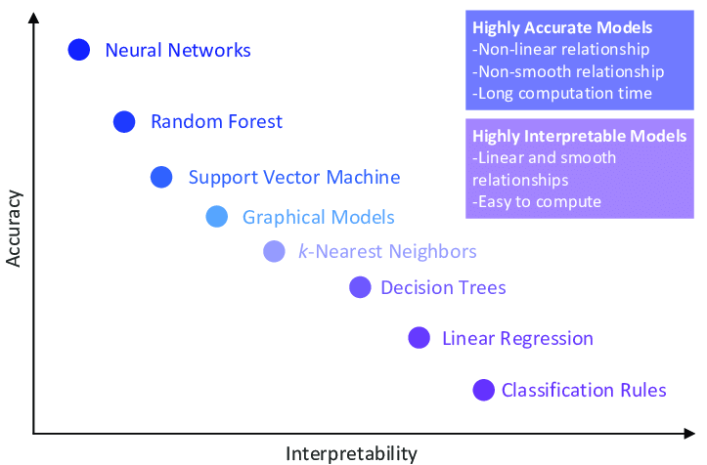
Accuracy vs Interpretability

Slide 30
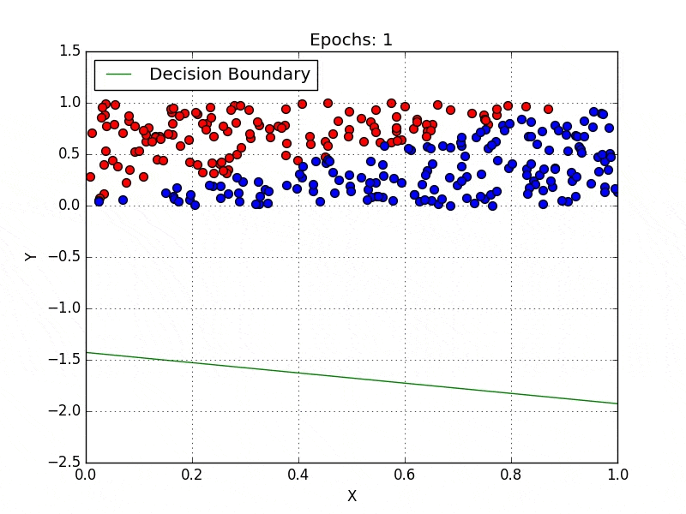
Interpretable models
In his book, “Interpretable Machine Learning”, Christoph Molnar defines interpretability as the degree to which a human can understand the cause of a decision or the degree to which a human can consistently predict ML model results.

Slide 31
Interpretable models
Linear models such as linear regression, SVMs with linear kernel, etc follow the linearity principle that two or more variables can be added together so that their sum is also a solution. E.g y = mx + c .
So a change in one of the features will affect the output. This is easy to understand and explain.

Slide 32
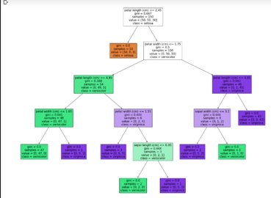
Interpretable models
Models that use decision trees are trained by learning simple decision rules gotten from prior data.
Since they follow a specific set of rules, understanding the outcome simply depends on learning and understanding the rules that led to the outcome

Slide 33
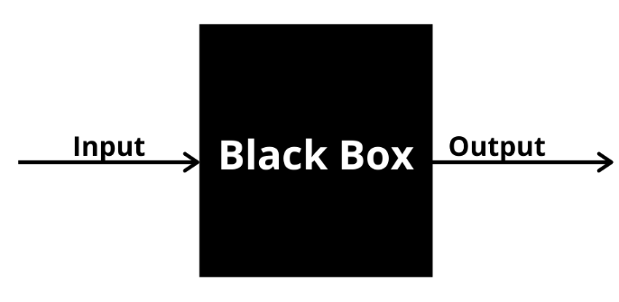
Blackbox models
Black box models are least interpretable by humans
Artificial Neural Networks
Extreme Learning Machine
Deep Neural networks

Slide 34
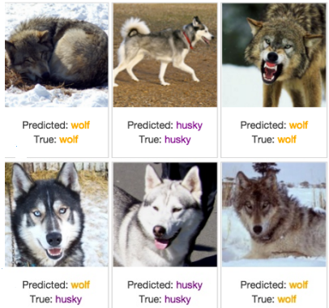
Wolf vs Husky Prediction - Deep Neural networks

Slide 35
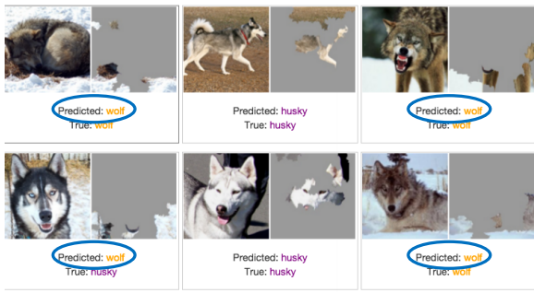
Wolf vs Husky - Explanation

Slide 36
Local Explanations vs Global Explanations
Explain individual predictions
Explain complete behavior of the model
Help unearth biases in the local neighborhood of a given instance
Help shed light on big picture biases affecting larger sub groups
Help vet if individual predictions are being made for the right reasons
Help vet if the model, at a high level, is suitable for deployment
Notes:
Model's reliance on spurios features
This might seem like trivial issues, but in practice these factors play a crucial role.
High level authority to approve these models are ready to be deployed

Slide 37
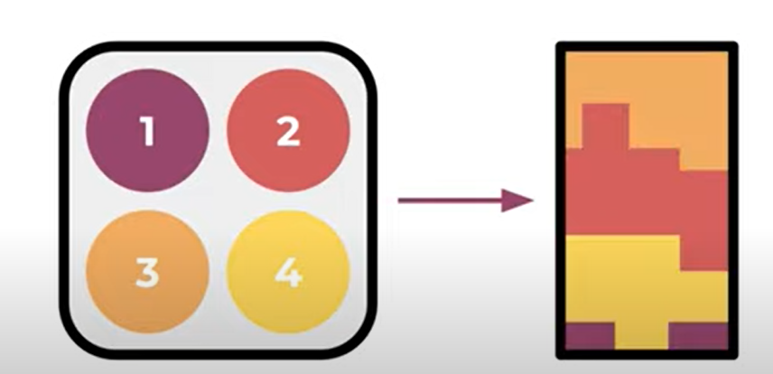
SHAP
SHAP values interpret the impact of having a certain value for a given feature in comparison to the prediction we'd make if that feature took some baseline value
Features
Feature Contribution towards output
Notes:
https://www.youtube.com/watch?v=VB9uV-x0gtg
Estimate marginal contribution of each feature towards prediction

Slide 38
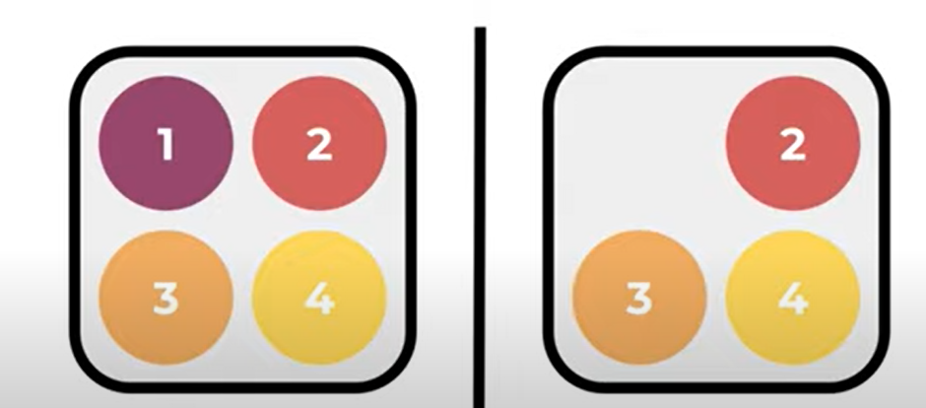

SHAP
Features
Feature Contribution towards output

Slide 39
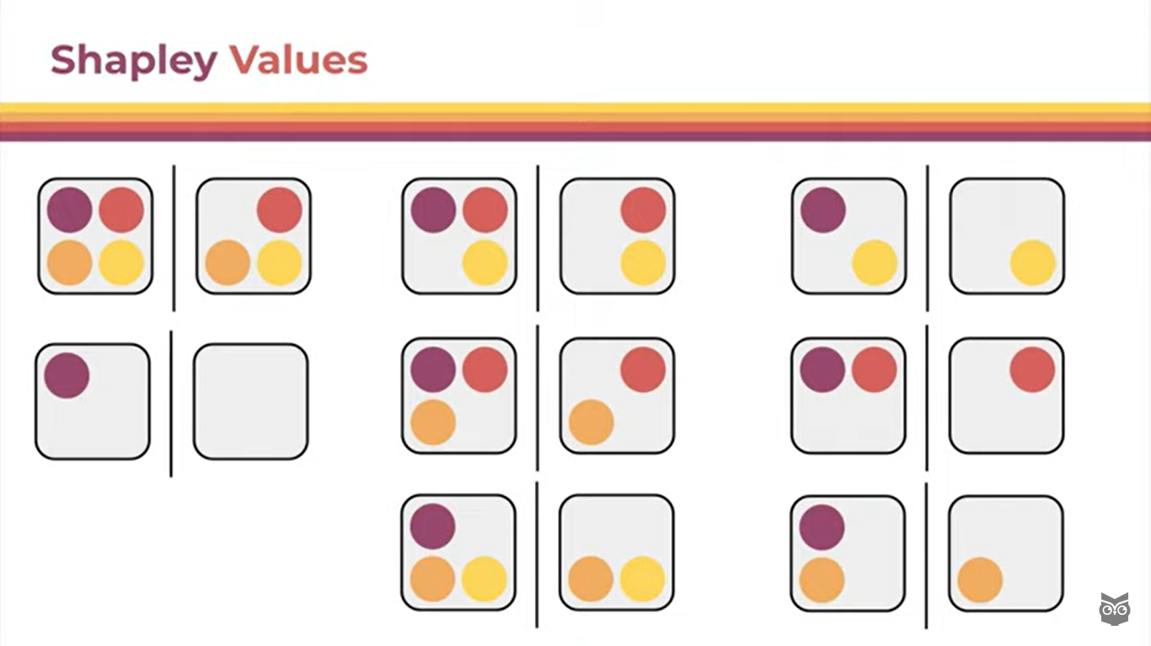
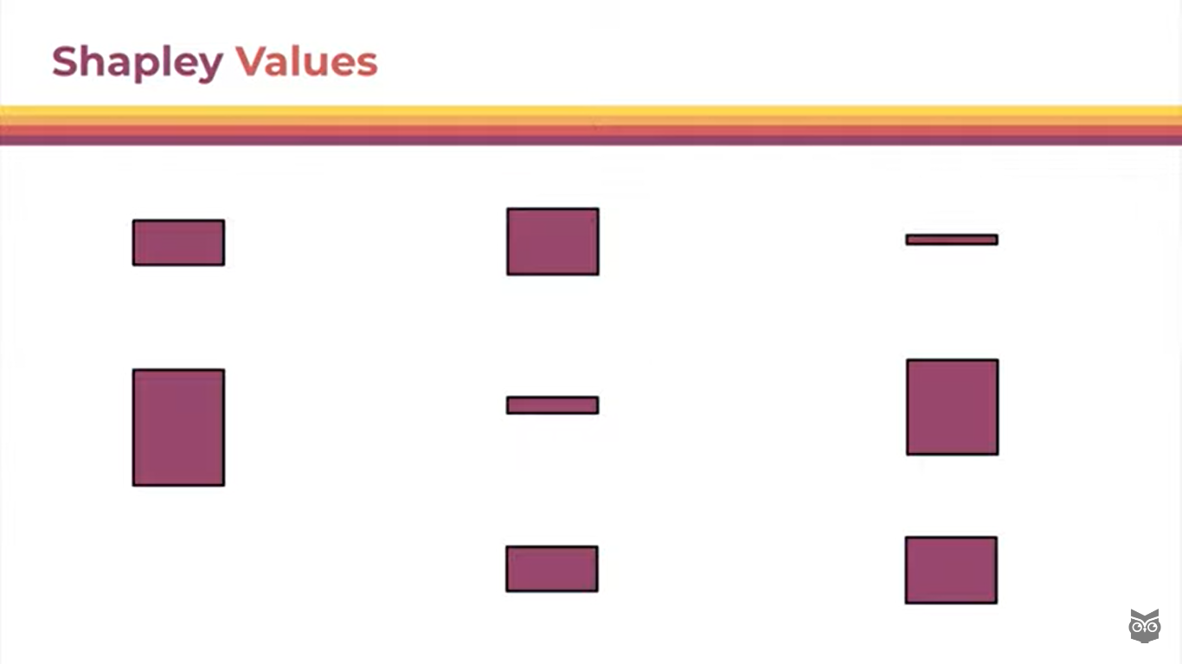
SHAP
Feature Contribution towards output
Features

Slide 40
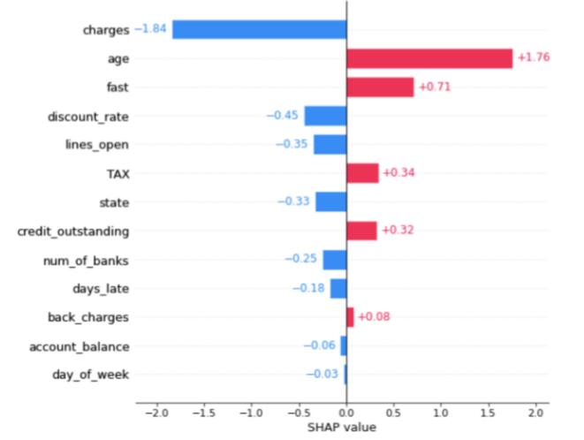
SHAP

Slide 41
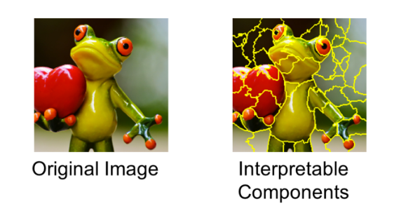
LIME
LIME, or Local Interpretable Model-Agnostic Explanations, is an explainability method that attempts to provide local ML explainability.
At a high level, LIME attempts to understand how perturbations in a model’s inputs affect the end-prediction of the model.
Since it makes no assumptions about how the model reaches the prediction, it can be used with any model architecture, hence the “model-agnostic” part of LIME.

Slide 42
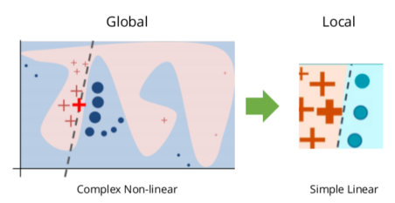
How does LIME work?
The model's decision function is represented by the blue/pink background, and is clearly nonlinear.
The bright red cross is the instance being explained (let's call it X).
We sample instances around X, and weight them according to their proximity to X (weight here is indicated by size).
We then learn a linear model (dashed line) that approximates the model well in the vicinity of X, but not necessarily globally.

Slide 43
How does LIME work?
Sample
Sample points around x_{i}
Predict
Use model to predict label for each sample
Weigh
Weigh samples according to distance x_{i}
Learn
Learn simple linear model on weighted samples
Explain
Use simple linear model to explain
Notes:
We are trying to explain individual predictions of a model
Given, a decision surface, the way we proceed with the algorithm is that we take the sample at hand
Create instances around, xi by adding random gaussian noises
Points closer to xi get higher weightage
Fit a simple linear model on weighted models
The coefficients becomes our explanations

Slide 44
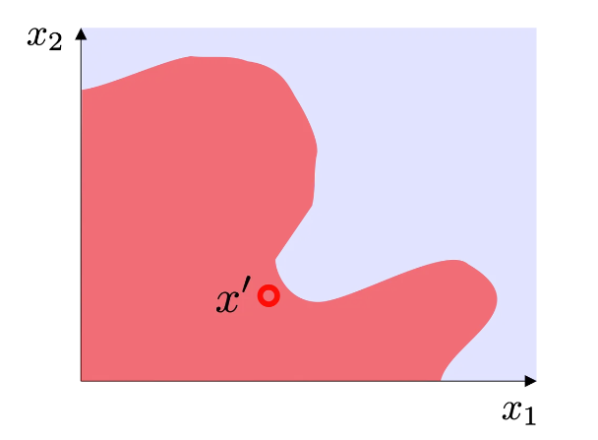
Step 1: Sample
Notes:
We are trying to explain individual predictions of a model
Given, a decision surface, the way we proceed with the algorithm is that we take the sample at hand
Create instances around, xi by adding random gaussian noises
Points closer to xi get higher weightage
Fit a simple linear model on weighted models
The coefficients becomes our explanations

Slide 45
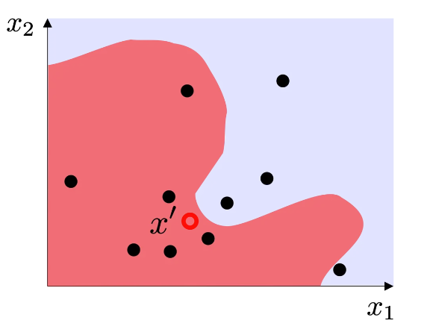
Step 1: Sample
Notes:
We are trying to explain individual predictions of a model
Given, a decision surface, the way we proceed with the algorithm is that we take the sample at hand
Create instances around, xi by adding random gaussian noises
Points closer to xi get higher weightage
Fit a simple linear model on weighted models
The coefficients becomes our explanations

Slide 46
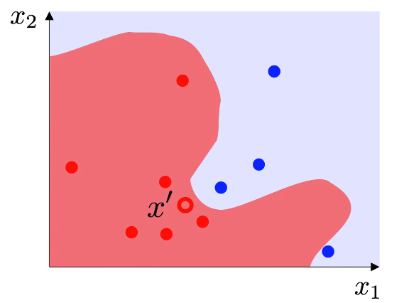
Step 2: Predict
Notes:
We are trying to explain individual predictions of a model
Given, a decision surface, the way we proceed with the algorithm is that we take the sample at hand
Create instances around, xi by adding random gaussian noises
Points closer to xi get higher weightage
Fit a simple linear model on weighted models
The coefficients becomes our explanations

Slide 47
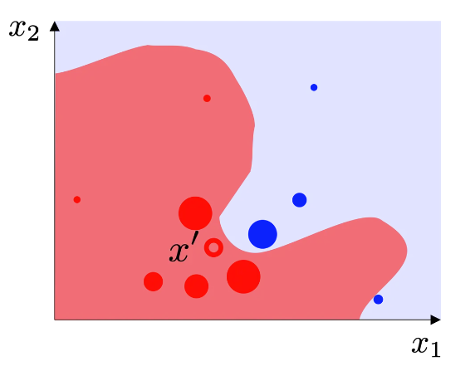
Step 3: Weigh
Notes:
We are trying to explain individual predictions of a model
Given, a decision surface, the way we proceed with the algorithm is that we take the sample at hand
Create instances around, xi by adding random gaussian noises
Points closer to xi get higher weightage
Fit a simple linear model on weighted models
The coefficients becomes our explanations

Slide 48
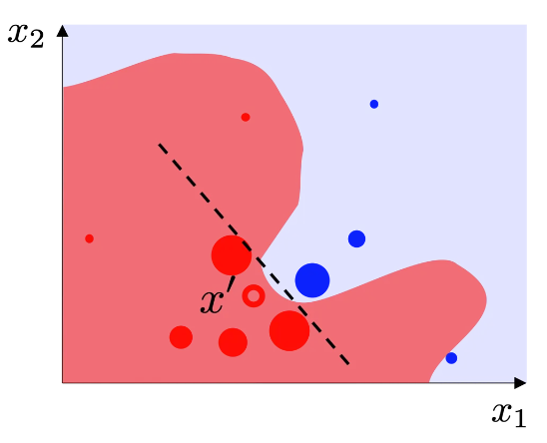
Step 4: Learn
Notes:
We are trying to explain individual predictions of a model
Given, a decision surface, the way we proceed with the algorithm is that we take the sample at hand
Create instances around, xi by adding random gaussian noises
Points closer to xi get higher weightage
Fit a simple linear model on weighted models
The coefficients becomes our explanations

Slide 49
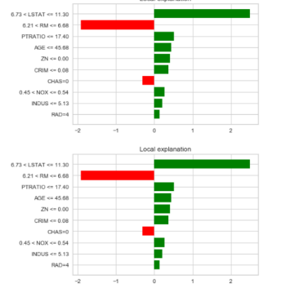
Step 5: Explain
Notes:
We are trying to explain individual predictions of a model
Given, a decision surface, the way we proceed with the algorithm is that we take the sample at hand
Create instances around, xi by adding random gaussian noises
Points closer to xi get higher weightage
Fit a simple linear model on weighted models
The coefficients becomes our explanations

Slide 50
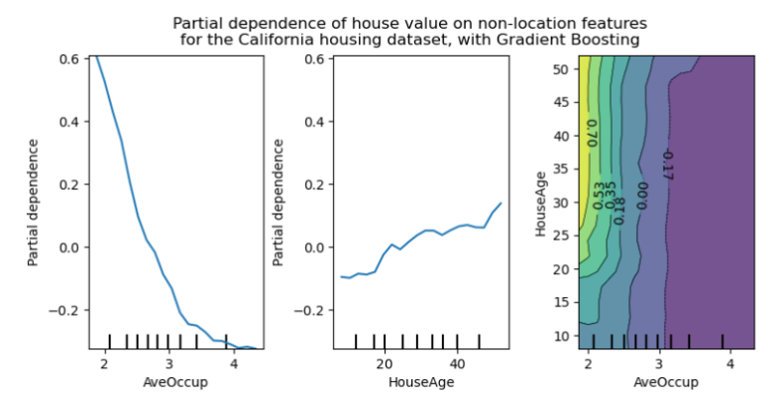
Partial Dependence Plot
PDP gets a a global visual representation of how one or two features influence the predicted outcome of the model, with other features held constant.
PDP tells if the relationship between the target and chosen feature is linear or complex.
PDP is also model-agnostic.
Notes:
https://neptune.ai/blog/explainability-auditability-ml-definitions-techniques-tools

Slide 51
How does PDP work?
Train
Train the model on the training data set
Replicate & resample
Replicate the dataset for 'm' number of times
Predict
Get prediction for this new sampled set
Average
Average for each unique value
Notes:
We are trying to explain individual predictions of a model
Given, a decision surface, the way we proceed with the algorithm is that we take the sample at hand
Create instances around, xi by adding random gaussian noises
Points closer to xi get higher weightage
Fit a simple linear model on weighted models
The coefficients becomes our explanations

Slide 52
Explainable AI - Summary
For a safe, reliable inclusion of AI, a seamless blend of human and artificial intelligence is needed.
Human intervention should also be considered for techniques that allow practitioners to easily evaluate the quality of decision rules in use, and reduce false positives.
Make XAI as a core competency as part of Machine learning problem design
75%
Of businesses say it is important for them to be able to trust AI’s analysis and recommendations

Slide 53
Why MLOps?
Section - 3

Slide 54


Business Value
Researcher/Data Scientist: Model is performing very well on test set
Product Owner: However, this isn't flexible/feasible for the application

Slide 55
Practical AI
Did you Know?
As of 2022, only 1 out of 2 Machine Learning Projects are successful

Slide 56

Why do models Fail?
Misalignment between actual Business need and machine learning objectives
Model did not generalize
Model testing/validation issues
Deployment hurdles

Slide 57

MLOps for the aid
It is an engineering discipline that aims to unify ML systems development(dev) and ML systems deployment(ops) to standardize and streamline the continuous delivery of high-performing models in production

Slide 58
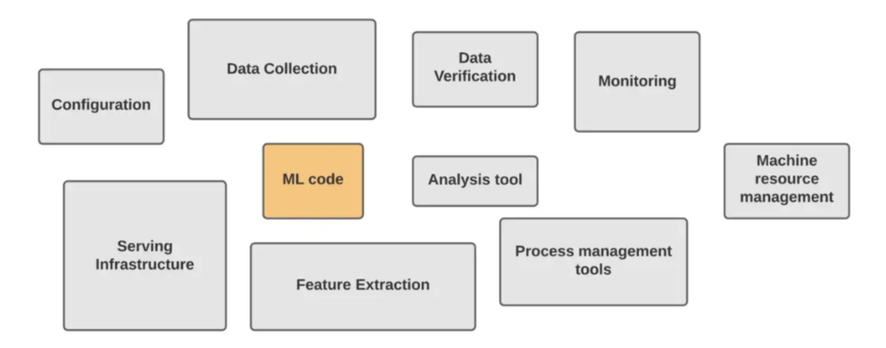
Components of MLOps

Slide 59
CRISP-DM
CRoss Industry Standard Process for Data Mining

Slide 60
Modeling process
Data Refresh
Hyperparameters + Model selection
Training
Error Analysis
Feature Engineering

Slide 61
AI Development Types
Section - 3.1

Slide 62
Model vs Data
Model-centric view | Data-centric view
Collect whatever data we have and build a model good enough | Data consistency is paramount. Continuously improvise the data
Hold the data fixed and iteratively improve the code | Hold the code fixed and iteratively improve the data
This involves selecting the best model architecture and training process from a wide range of possibilities | Use of tools to improve data quality. This will allow multiple models to do well
90% of research papers are model-centric
Notes:
https://neptune.ai/blog/data-centric-vs-model-centric-machine-learning

Slide 63
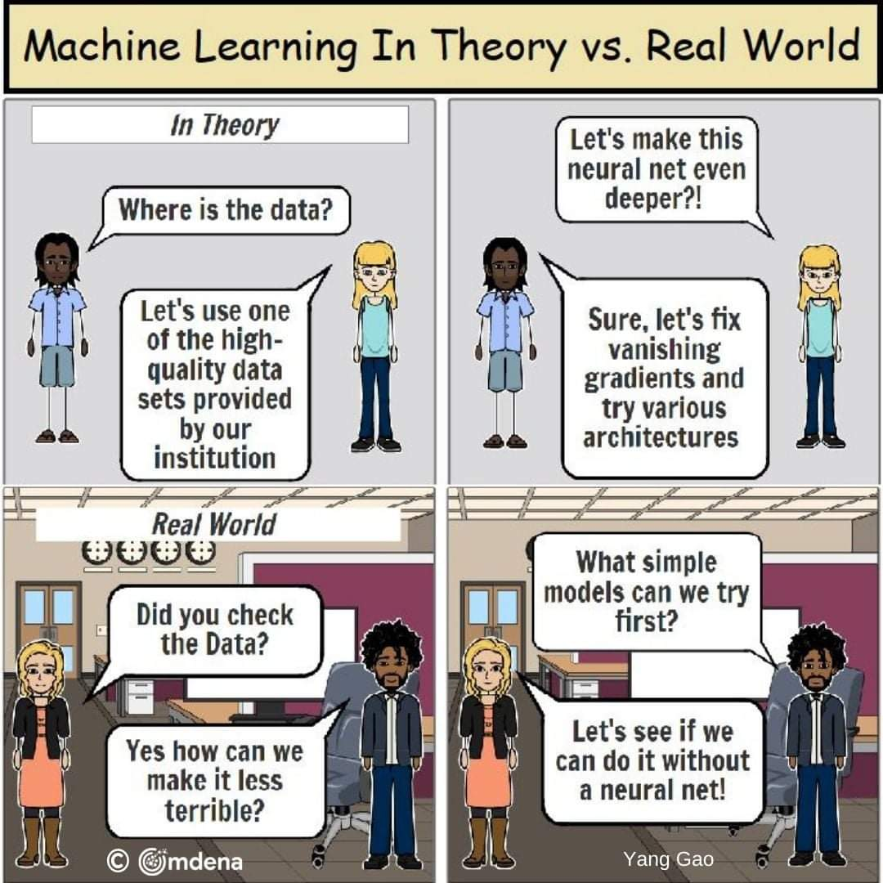
Practical AI

Slide 64
Drifts in Production
Section - 3.2

Slide 65
Types of Drift
Once the model is tested, it moves to production. Eventually, the model’s performance begins to degrade, and more often than not, this is due to concept drift.
Types of Drifts:
Concept drift
Data drift
Label drift
Notes:
https://www.aporia.com/blog/concept_drift_in_machine_learning_101/

Slide 66
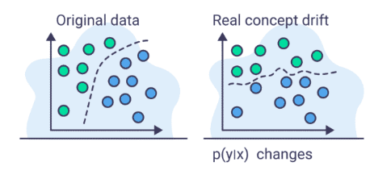
Concept Drift
Different ways:
Sudden drift
Gradual drift
Incremental drift
Recurring drift
Concept drift is a situation in which the statistical properties of a target variable (what the model is trying to predict) changes over time in unforeseen ways

Slide 67
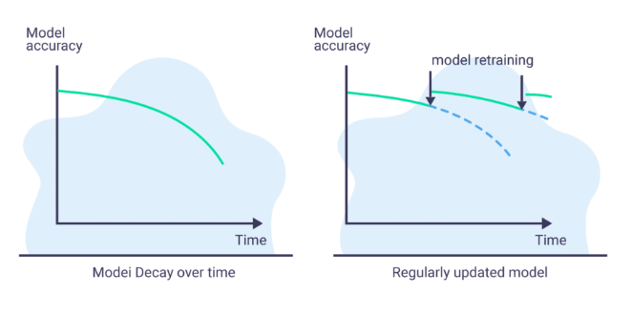
Concept drift
How to overcome:
It has been shown that regularly retraining the model before the point of significant degradation has occurred helps alleviate the issue to some extent

Slide 68
Concept drift
Challenges:
We don’t always know the timeframe after which we need to retrain
the time window for retraining is in flux and so this parameter itself needs to be monitored and optimized
retraining simply isn’t enough. A significant change in the concept may require an entirely new type of model.
the change originates from flaws in other parts of the pipeline such as schema changes, dropped fields, application bugs, and more

Slide 69
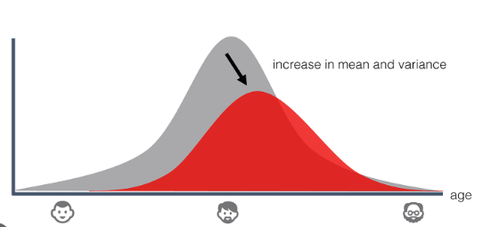
Data Drift (Feature drift)
Data-drift is defined as a variation in the production data from the data that was used to test and validate the model before deploying it in production.

Slide 70
Data Drift Detection Techniques
Population Stability Index (PSI)
Kolmogorov-Smirnov test (KS test)
Wasserstein metric
KL Divergence
Model Based approach
ADWIN

Slide 71
Kolmogorov-Smirnov (KS) test
Given two samples, test whether they belong to same probability distribution (null hypothesis) or not(alternate hypothesis)
Type: Numerical
Interpretation: Statistical confidence

Slide 72
How to calculate KS - Test
Concatenate
Concatenate values in D1 & D2 in one sorted array
CDF
Compute the observed cumulative distribution functions of the two samples
Difference
Compute their maximum absolute difference. (drift)
Compare
Compare drift > D_crit. [D_crit is 95% critical value]. If drift is less than critical value, we have failed to reject the null hypothesis.
Drift
drift_detected = True if drift > D_crit else False

Slide 73
Population Stability Index (PSI)
Identifies the shift between two distributions. It is done by bucketing (decile) the two distributions and comparing the percentage of items in each of the buckets, resulting in a single number
Type: Numerical
Interpretation:
PSI < 0.2: moderate change
PSI >=0.2: significant change
PSI < 0.1: no significant change

Slide 74
How to calculate PSI
Feature sort
Sort values of feature for both D1 & D2
Decile
Split the variable feat into 10 groups
Top
Calculate % of records of feat in each 10 group on sample D1 & D2
Difference
Compute the difference using the PSI formula.
Drift
PSI < 0.1: no significant change
PSI < 0.2: moderate change
PSI >= 0.2: significant change

Slide 75
Model Based Test
Given two samples, use a ML model to determine the similarity between two samples
Type: Numerical & categorical
Interpretation:
Train the classifier and predict the differences, if the model has high AUC (>0.9), it implies the distribution is significantly different

Slide 76
Wasserstein’s distance
Also, known as Earth Mover’s distance
Type: Numerical
Interpretation:
Feature values
Measures how much earth (probability density) needs to be moved and how far to transform one distribution to another.

Slide 77
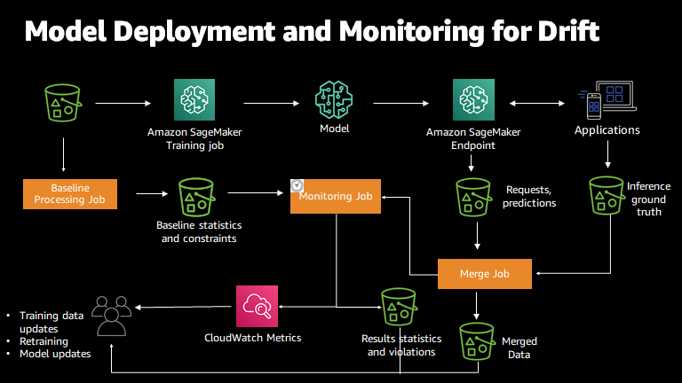
Sagemaker Model Monitor

Slide 78
Machine Learning in Production
Section - 3.3

Slide 79
Stages of AI Automation
Human only
Shadow
AI Assistance
Partially AI Driven
Completely AI Driven

Slide 80


Modeling process
Training Pipeline
Inference Pipeline

Slide 81
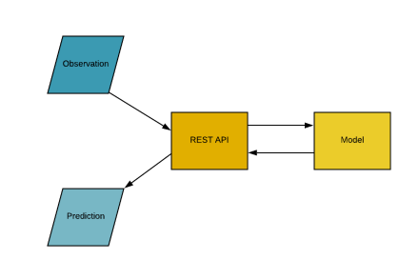
1. Online Inference
Online Inference is the process of generating machine learning predictions in real time upon request.
It is also known as real time inference or dynamic inference.
Typically, these predictions are generated on a single observation of data at runtime.
Predictions generated using online inference may be generated at any time of the day.

Slide 82
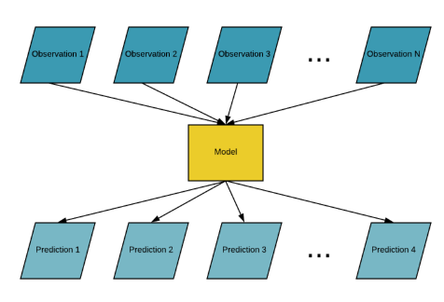
2. Batch Inference
Batch inference, or offline inference, is the process of generating predictions on a batch of observations.
The batch jobs are typically generated on some recurring schedule
These predictions are then stored in a database and can be made available to developers or end users

Slide 83
Value Driven Machine Learning
Data Centric
Open source data
Quality data over more data
Baseline
Identify state of art models
Human level metrics
Model
Simple deployable model
Intuitive features
Refresh
Pipelines
Inference

Slide 84
Wrap up

Slide 85
References
https://www.montecarlodata.com/blog-why-production-machine-learning-fails-and-how-to-fix-it/
https://www.datanami.com/2022/08/22/half-of-ai-models-never-make-it-to-production-gartner/
https://www.mckinsey.com/capabilities/quantumblack/our-insights/why-businesses-need-explainable-ai-and-how-to-deliver-it
Explainable Object Detection - a practical How To (steadforce.com)
What is explainable AI? 6 benefits of explainable AI | Engati
https://neptune.ai/blog/explainability-auditability-ml-definitions-techniques-tools
https://neptune.ai/blog/data-centric-vs-model-centric-machine-learning
https://www.oberlo.in/blog/artificial-intelligence-statistics
https://explodingtopics.com/blog/ai-statistics
https://www.oreilly.com/content/introduction-to-local-interpretable-model-agnostic-explanations-lime/
https://towardsdatascience.com/what-is-mlops-everything-you-must-know-to-get-started-523f2d0b8bd8
https://www.aporia.com/blog/concept_drift_in_machine_learning_101/
https://mlinproduction.com/batch-inference-vs-online-inference/

Slide 86
References
https://www.openlayer.com/blog/post/understanding-lime-in-5-steps
https://medium.com/better-ml/drift-detection-6db05bf75dfe

